Slide 1
The Battle of Neighbourhoods
-By Sruthi Pedakolimi

Slide 2
Business Problem
A Customer, Sundar, wants to open a new gaming arcade in USA
He defines a best locality based on the following constraints,
Population Density
Popular Venues in the location
We have to suggest the best location to setup the arcade in the United States

Slide 3
Data
List of cities in United States with population density and location coordinates
https://en.wikipedia.org/wiki/List_of_United_States_cities_by_population
Using the FourSquare API to get the following
List of all venues in each city
List of all venues in each locality of the selected city

Slide 4
Methodology
The Following steps were followed to select the best location in United Sates
The Wikipedia page https://en.wikipedia.org/wiki/List_of_United_States_cities_by_population was scrapped using the BeautifulSoup library to build a pandas dataframe listing the city,state,land area,population density and location .
The Foursquare API was then used to query each of the city to get {venue names,venue category,venue latitude and longitude} within the given radius . The resulting locations for each venue were tabulated and stored in a new dataframe and visualised using Folium.

Slide 5
Methodology
The K Means Algorithm was used for clustering clustering was applied to the selected categories latitudes and longitudes and calculated the weightage for each cluster
Then the cluster centroid which has more weightage is selected for the clients gaming arcade

Slide 6
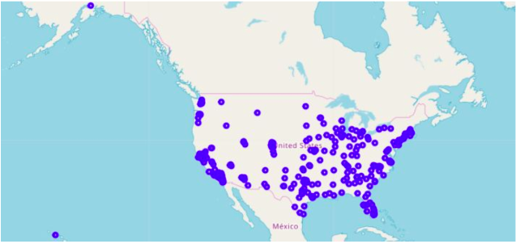
Plot of Cities of United States
Blue dots represents the cities in the United States

Slide 7
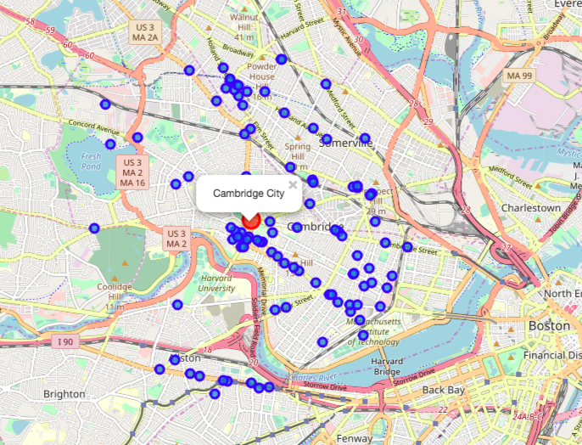
Map of Venues in the Cambridge City
The blue circles represents the venues in the Cambridge city

Slide 8
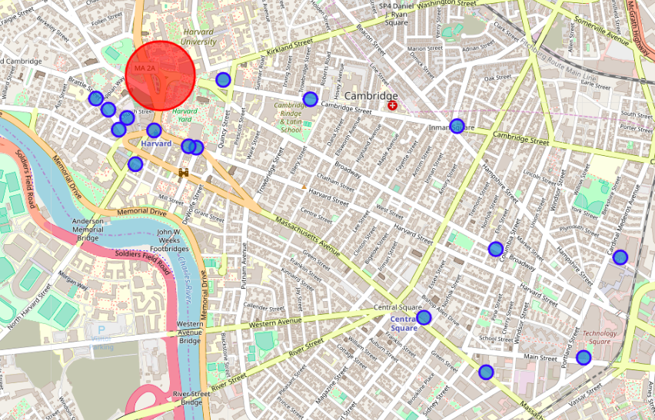
Result
The red circle represents the best location to start an arcade in cambridge city

Slide 9
Improvements/Recomendations
The Following analysis can be improved with the following extensions
Here we can consider few more categories. For example Schools,Universities whcih is also a good source for customers
We can also select multiple locations based on the localities and neighbourhoods to improve the accuracy of the score
We can extend the area by increasing the radius and the limit value so that we can cover more venues

